Slide 1
Azure Function App Health
Abusing the Azure Functions Runtime for fun and profit

Slide 2
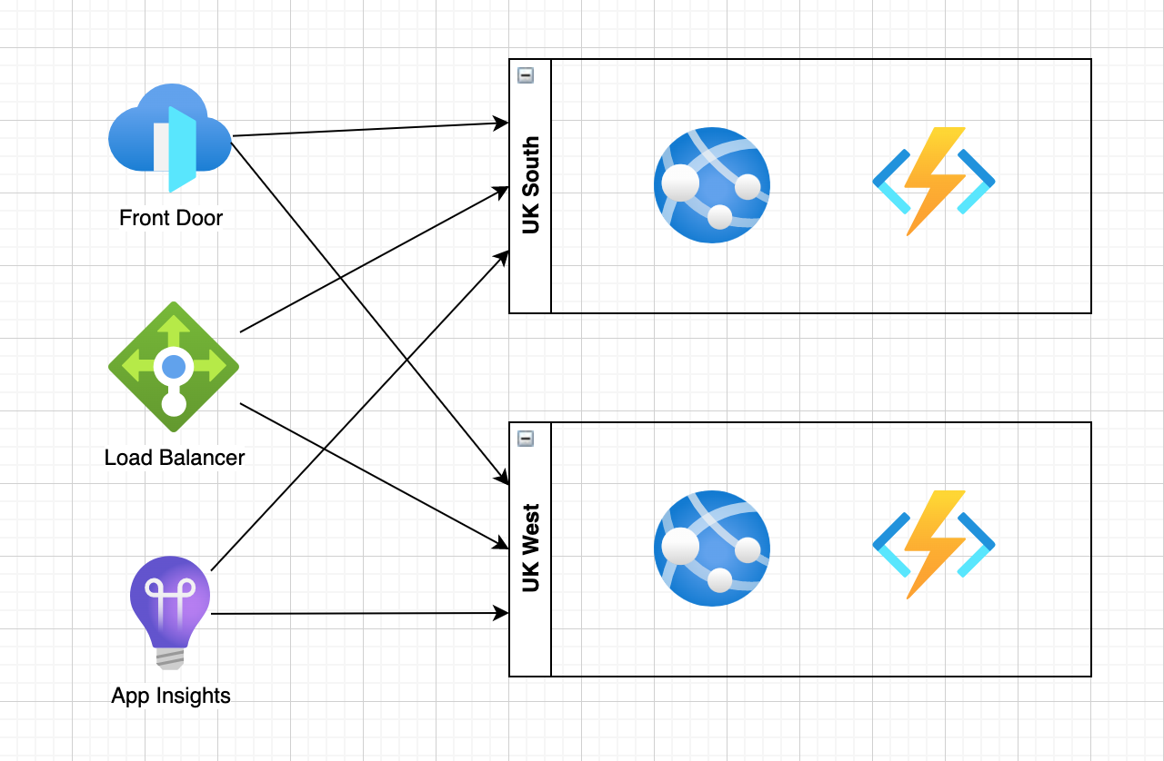
Health Check Endpoint Pattern
Instances expose health endpoint
👍 Healthy
🤢 Degraded
☠️ ☠️ ☠️
Monitoring systems poll health endpoints of all instances
Traffic routed accordingly
https://microservices.io/patterns/observability/health-check-api.html

Slide 3
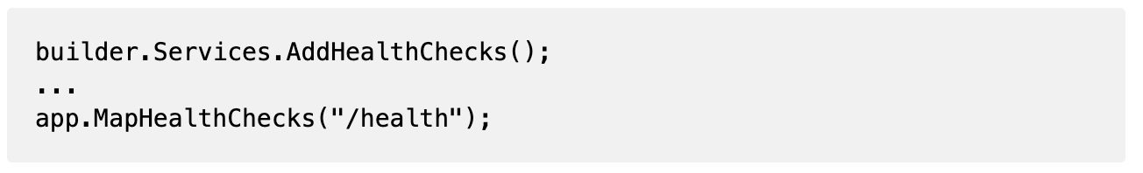
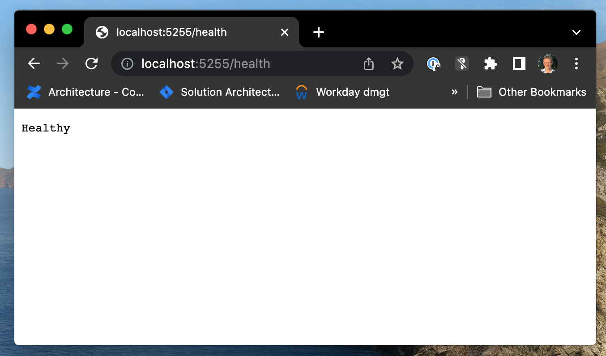
ASP.Net Web API
To add the standard health endpoint
Then add health checks

Slide 4
Azure Function Apps
Azure Functions Runtime
Doesn’t support WebApplicationBuilder 😢
Doesn’t support programmatic routing 😞
Doesn’t support functions in separate assemblies 😫
Does support ‘Extensions’ 😎
https://github.com/Azure/azure-functions-openapi-extension

Slide 5
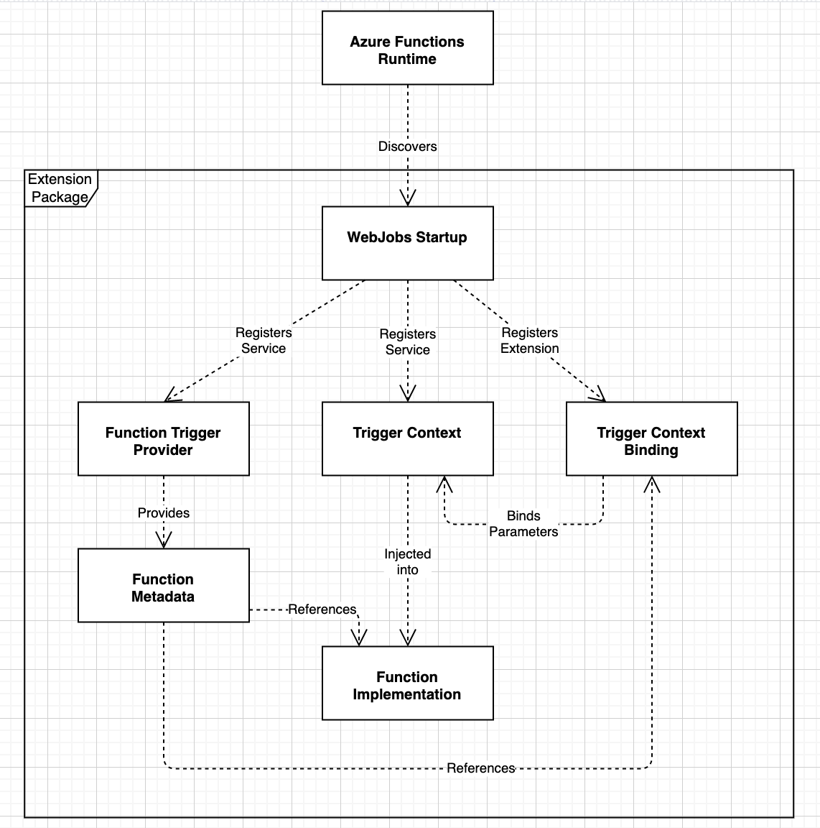
Anatomy of an Extension
WebJobs Startup
Registers Services & Extension
Trigger Provider
Registers function metadata
Trigger Context Binding
Allows config / service injection
Via Tigger Context class
Function Implementation
Does the work!

Slide 6
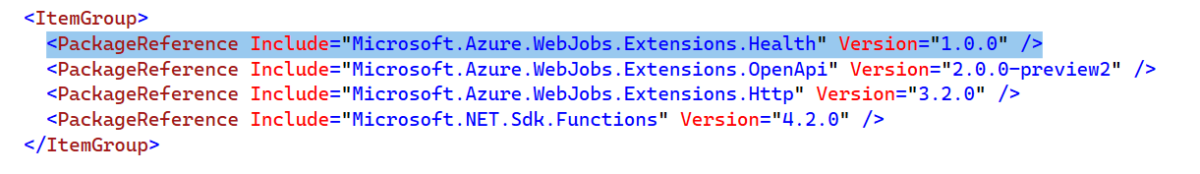
Azure Function App
To add the standard health endpoint
Then add health checks

